Slide 1


Answer Engine
Optimization
The Future of Search is Here
Powered by [YOUR AGENCY BRAND HERE]

Slide 2


The Search Landscape
is Changing
180M+
Active ChatGPT users asking questions daily
43%
Of searches now start with AI assistants instead of Google
68%
Of consumers trust AI-generated answers more than traditional ads
Your customers are asking AI assistants about your industry.
Is your business being cited?

Slide 3





The AEO Opportunity
Become the Trusted Authority
Early Adopter Advantage
When AI platforms cite your business, you're positioned as the definitive expert—building trust before prospects even visit your website.
Most businesses haven't discovered AEO yet. Establish authority now before your competitors catch on and the market becomes saturated.
Higher Quality Traffic
Future-Proof Your Business
AI-referred visitors are pre-qualified and educated. They arrive knowing you're the expert, leading to higher conversion rates.
As traditional search declines, AEO ensures your business remains visible where your customers are actually looking for answers.
The question isn't whether to invest in AEO—it's whether you'll lead or follow.

Slide 4
Introducing the SPARK Framework™
A Proven, Systematic Approach to Answer Engine Optimization
S
P
A
R
K
Schema & Structure
Platform Authority
Answer Readiness
Relevance Signals
Knowledge Integration
Machine-readable data layers that AI platforms understand
Establish your brand as the trusted source across AI platforms
Content structured for direct AI citation and response
Strategic optimization for AI understanding and ranking
Comprehensive knowledge systems that position you as the expert
Developed from months of research and real-world testing across diverse industries

Slide 5

TIER 1
SPARK Foundation™
Essential AEO Foundation for Forward-Thinking Businesses
$2,997
/month
Key Deliverables
Advanced schema markup (25 pages, 7+ types)
5 comprehensive FAQ pages
15 pages optimized for featured snippets
AI crawler optimization & analytics tracking
Brand mention monitoring across all AI platforms
Monthly content refresh (2 pages)
Up to 50 pages optimized total

Slide 6

TIER 1 - FOUNDATION
Expected Year 1 Results
SPARK Foundation™
50-100%
10-20
Increase in organic traffic
Brand mentions in AI responses
5-10
150-200%
Featured snippets captured
Return on investment
Ideal For
Small to mid-sized businesses with 25-100 page websites
12-month program | Up to 50 pages optimized

Slide 7










SPARK Growth
Mid-Market
$6,497
/month
($77,964 annually)
Everything in Foundation
plus advanced features
120 pages optimized
over 12 months
8 pillar content pages
(3,000-5,000 words each)
6 how-to guides
+ 4 comparison guides
50-term industry glossary
establishing authority
Topic cluster architecture
with semantic optimization
Advanced schema
across 60 pages (12+ types)
Entity mapping
and knowledge base architecture
Bi-weekly strategy calls
with dedicated strategist
Competitive AEO analysis
tracking top competitors
Expected Year 1 Results:
100-200%
25-50
15-25
200-300%
Traffic Increase
AI Citations
Featured Snippets
ROI

Slide 8







SPARK Enterprise™
Dominant AI Search Presence for Industry Leaders
$12,997/month
Up to 250 pages optimized | 12-month program
Everything in Foundation & Growth, Plus:
100 Knowledge Base Articles
10 Ultimate Guides
(5,000-7,000
Original Research Report
generating
establishing definitive authority
words each)
media attention
5 Professional Videos
optimized for AI
Knowledge Graph Development
API Integrations
(OpenAI, Perplexity)
understanding
connecting all entities
for automation

Slide 9



TIER 3 - ENTERPRISE
Additional Features & Support
Predictive Analytics
identifying
Dedicated Account Manager
(10-15
8 Pages Refreshed Monthly
with
opportunities first
hours/month)
optimization
Expected Year 1 Results
150-300%
50-100+
30-50
300-500%
Traffic Increase
AI Citations
Featured Snippets
ROI

Slide 10

Compare All Three Tiers
Foundation
Growth
Enterprise
Feature
$2,997
$6,497
$12,997
/month
/month
/month
Pages Optimized
50 pages
120 pages
250 pages
Schema Implementation
25 pages
60 pages
150 pages
FAQ Pages
5 pages
5 pages
5 pages
Pillar Content
—
8 pages
8 pages
Ultimate Guides
—
—
10 guides
Knowledge Base Articles
—
—
100 articles

Slide 11

Compare All Three Tiers: Results
Foundation
Growth
Enterprise
Feature
$2,997
$6,497
$12,997
/month
/month
/month
Monthly Content Refresh
2 pages
4 pages
8 pages
API Integrations
—
—
OpenAI + Perplexity
Dedicated Account Manager
—
—
✓
Expected Traffic Increase
50-100%
100-200%
150-300%
Expected AI Citations
10-20
25-50
50-100+
Expected ROI
150-200%
200-300%
300-500%

Slide 12

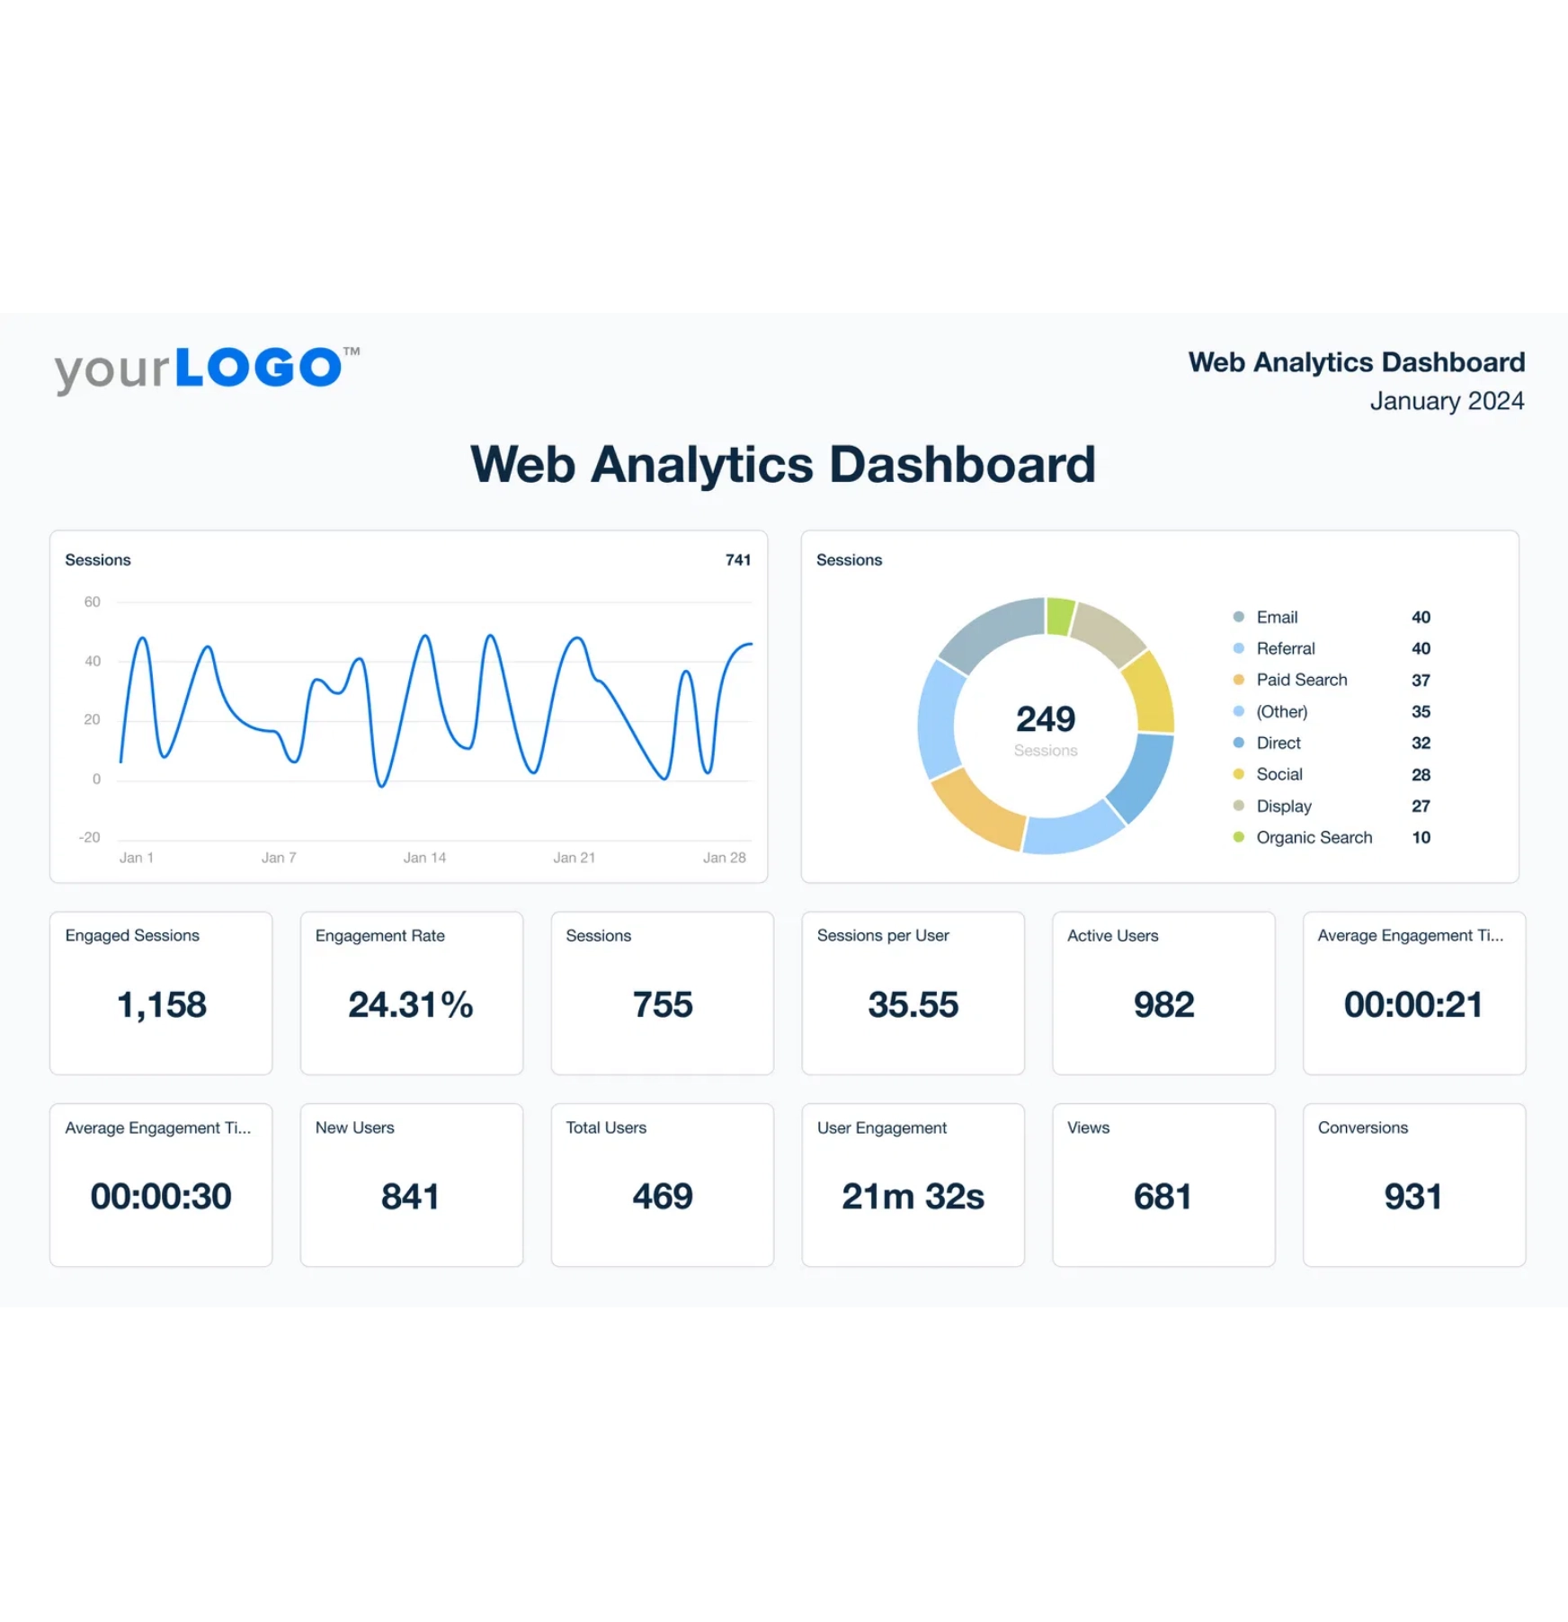
Expected Results & ROI
Foundation
Growth
Enterprise
$2,997
$6,497
$12,997
Traffic Increase
Traffic Increase
Traffic Increase
50-100%
100-200%
150-300%
AI Citations
AI Citations
AI Citations
10-20
25-50
50-100+
Featured Snippets
Featured Snippets
Featured Snippets
5-10
15-25
30-50
ROI
ROI
ROI
150-200%
200-300%
300-500%
Pages Optimized
Pages Optimized
Pages Optimized
50
120
250
Results based on 12-month program implementation

Slide 13



Why Act Now?
The Window is Closing
AEO is still in its early stages. Businesses that establish authority now will dominate AI search results for years to come. Once competitors catch on, it becomes exponentially harder to compete.
Your Customers Are Already There
43% of searches now start with AI assistants. Your customers are asking questions about your industry right now. If you're not optimized, your competitors are getting those referrals instead.

Slide 14



Why Act Now? (continued)
Compound Growth Effect
AEO results compound over time. The sooner you start, the more citations you accumulate, which leads to more authority, which leads to more citations. Delaying means missing months of exponential growth.
First-Mover Advantage
AI platforms favor established authorities. Being first in your industry creates a moat that's difficult for competitors to overcome. The brands optimized today will be the default answers tomorrow.
The question isn't if you'll invest in AEO—
it's
whether you'll lead or follow
.

Slide 15

Get Started Today
1
Schedule a consultation to discuss your agency's needs
2
Receive custom white-label pricing and partnership terms
3
Launch AEO services with your first client in 30 days
4
Scale to multiple clients with our proven delivery system

Slide 16


Contact Us
partners@agency.com
(555) 123-4567
Your Growth Partner for the Future of Search

